Slide 1
Medi Chair
Non-Invasive Vital Monitoring System

Slide 2
Presented By,
Group- 2024.2.13
Supervised by,
Dr. Shuvra Mondal

Slide 3
TEAM MEMBERS
01
SNEHASISH SAHA
02
SHAHINUZZAMAN SANIM
03
SHEIKH SALMAN
04
ANTOR SARKER BONDHON
Department of Electrical and Electronics Engineering American International University- Bangladesh

Slide 4
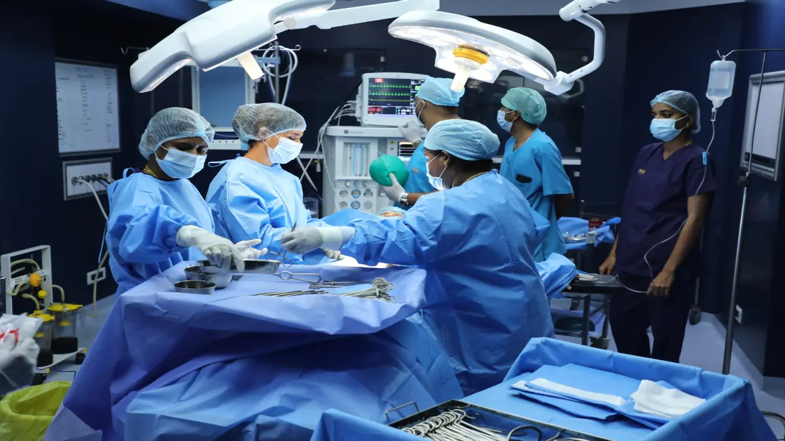
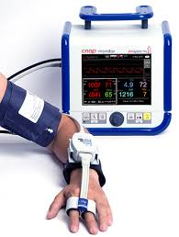
Future of Medical Science
Invasive
Non-Invasive
Operation Theatre
Health monitoring

Slide 5
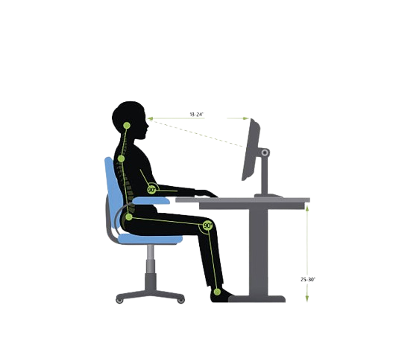
GOALS
Comprehensive Monitoring
Activity and Sleep Tracking
Seamless Integration
Real-Time Analysis
User-Friendly Interface
Enhanced Patient Care
Online Monitoring

Slide 6
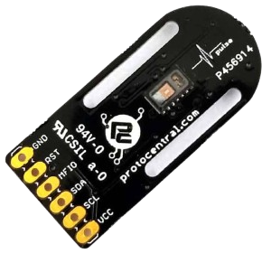
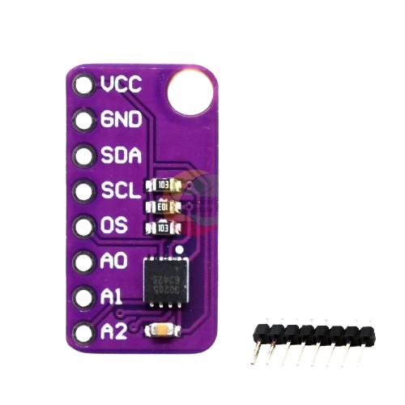
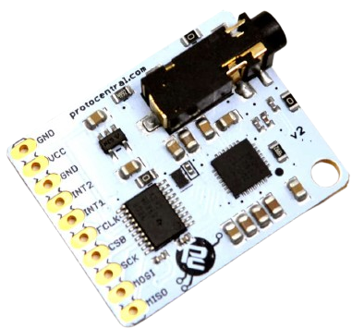
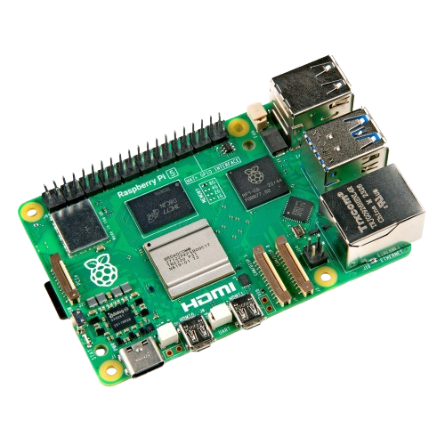
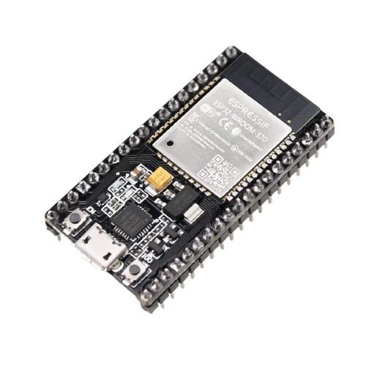
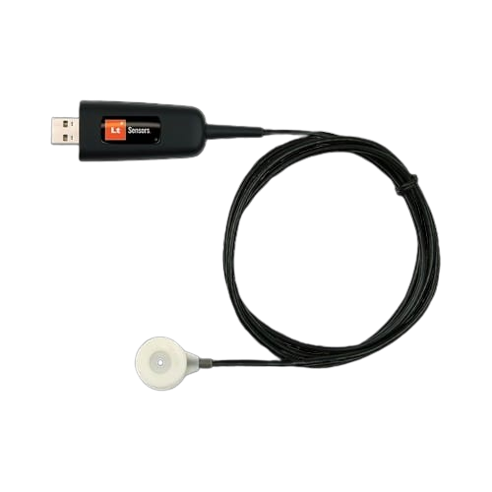
Sensors Used
Pulse-Ox & Heart Rate Sensor (MAX30102)
Body Temperature Sensor (MAX30205)
TinyGSR GSR/EDA Sensor
ESP32-WROOM-32
Cardio Microphone Sensor
Raspberry Pi 5

Slide 7
FLOW CHART
Human Hand
Chair Handel with Sensors
PPG
Analog Data
SpO2
Oxygen Saturation Level
Heart Rate
BPM
Systolic/Diastolic
BP Level
ECG
Analog Data
R-R interval
Cardiovascular Condition
EDA
Digital Data
Sweating State
Output
Stress Level
TEMPARATURE
Digital data
Skin Temperature
Body Temparature
Output
Temparature Condition
COPPER MASH
Digital Data
Output
Pressure point

Slide 8
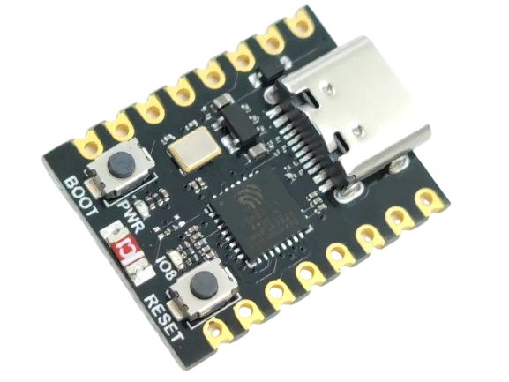




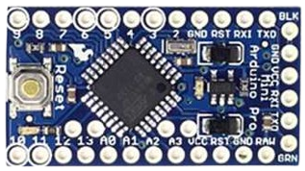
DATA FLOW
Sensors
Data Collection
Data visualization

Slide 9
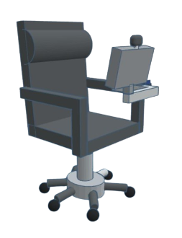
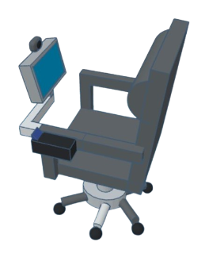
3D DESIGN
Display
Camera
Integrated
Sensors

Slide 10
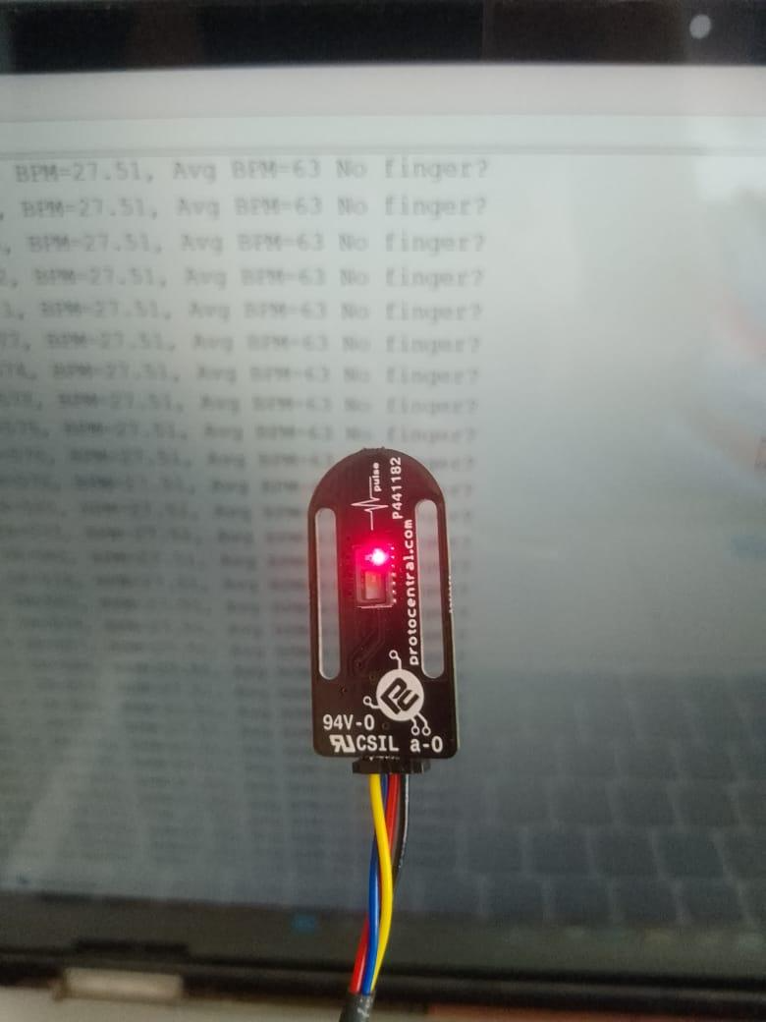
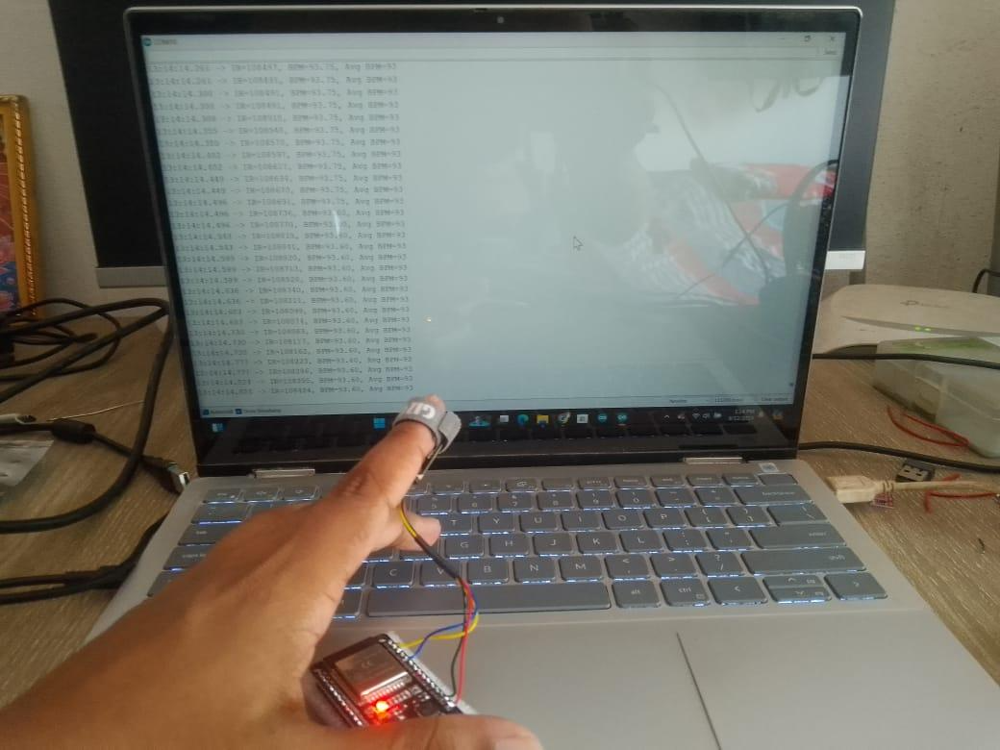
DEVELOPMENT PROCESS
Fig 1: Implement of pulse oximeter sensor
Fig 2: Testing and data collection of pulse oximeter sensor

Slide 11
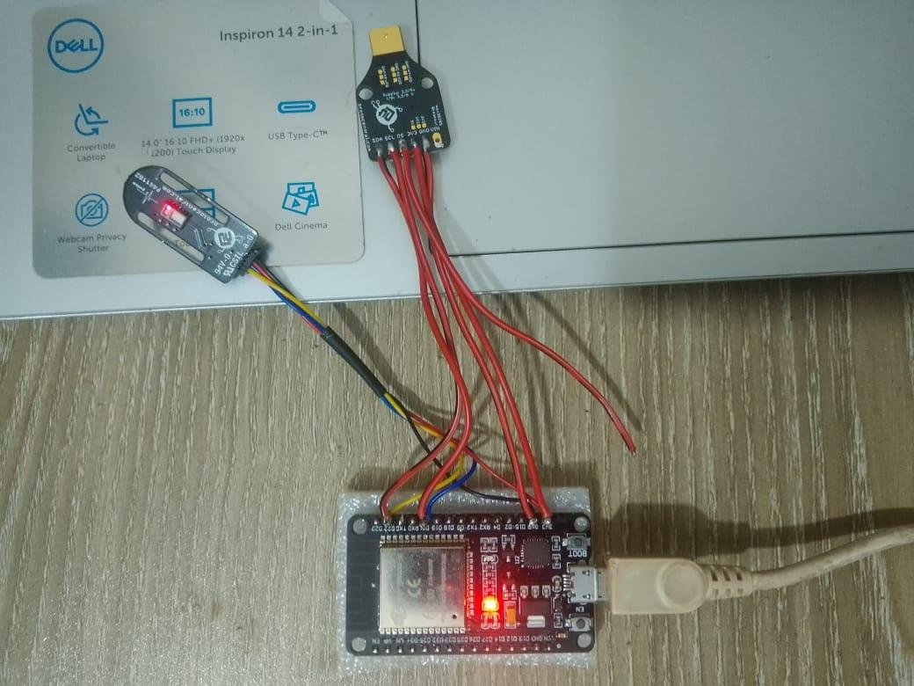
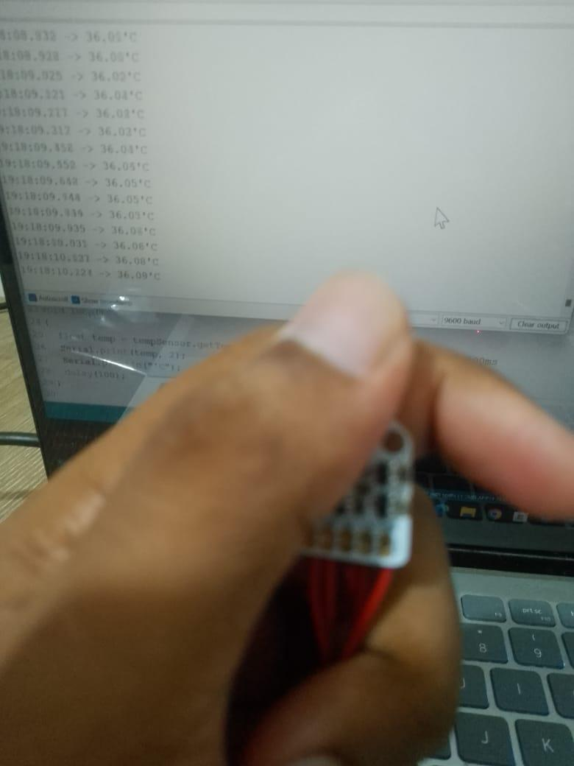
DEVELOPMENT PROCESS
Fig 1: Implement of Temperature Sensor
Fig 2: Testing and data collection of Temperature sensor

Slide 12
Some collected data from Oximeter sensor through serial port
13:14:46.926 | -> IR = 110061 | BPM 90.91 | Avg BPM=91
13:14:46.973 | -> IR = 110177 | BPM 90.91 | Avg BPM=91
13:14:47.020 | -> IR = 110363 | BPM 90.77 | Avg BPM=90
13:14:47.161 | -> IR = 109866 | BPM 90.77 | Avg BPM=90
13:14:47.208 | -> IR = 109565 | BPM=90.77 | Avg BPM=90
13:14:47.208 | -> IR = 109394 | BPM-90.77 | Avg BPM=90
13:14:47.208 | -> IR = 109313 | BPM=90.77 | Avg BPM=90

Slide 13
Some collected data from Temperature sensor through serial port
19:18:29.756 | -> 36.32'C
19:18:29.852 | -> 36.30'C
19:18:29.947 | -> 36.31'C
19:18:30.043 | -> 36.32'C
19:18:30.139 | -> 36.33'C
19:18:30.235 | -> 36.32'C
19:18:30.331 | -> 36.30'C

Slide 14
Limitations
User Adoption and Compliance
Technological Barriers in Rural and Underserved Areas
Limited AI Generalization
Regulatory Hurdles
Data Overload and Management
Battery Life and Energy Limitations

Slide 15
Future Scope
Use IoT and Cloud Systems for real-time monitoring.
Analyze Long-term Health Trends with collected data.
Collect User Feedback for system improvements.
Utilize AI for precise bio-signal analysis.
Create Adaptive Systems that learn from data.

Slide 16
THANKS!

